Slide 1
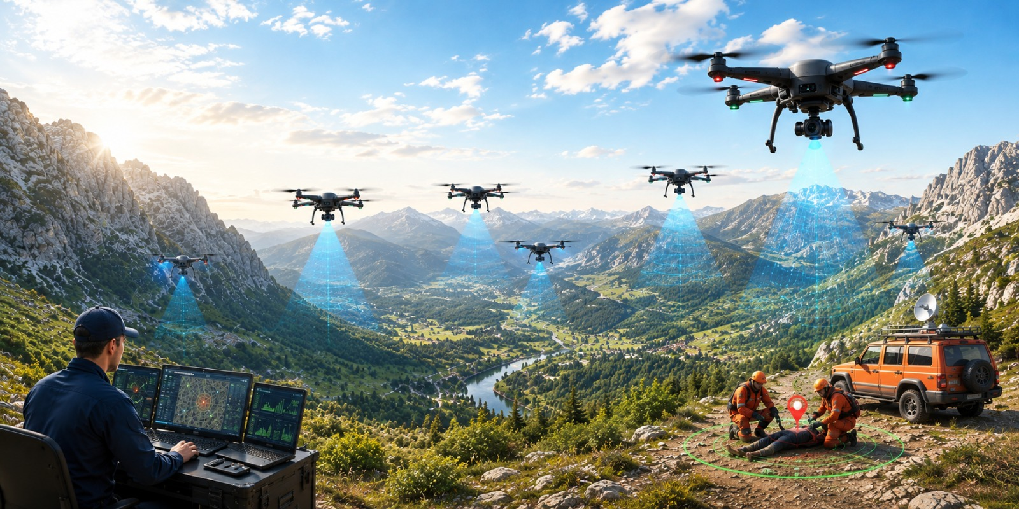
MLA0305-Reinforcement learning
MS1 Jul-Sep 2026 - SLOT B
Cooperative Drone Swarm Search and Rescue using Multi-Agent Reinforcement Learning and Swarm-Based Agent Simulation
Guided by, Dr. Vincent Gnanaraj T
Associate Professor
Department of Quantum Intelligence
SIMATS Engineering
Presented by, 192425196-P.Hithaishi
192472216-K.Sri Lasya
192525322-N.Parnita

Slide 2
Abstract
Cooperative Drone Swarm Search and Rescue using Multi-Agent Reinforcement Learning and Swarm-Based Agent Simulation proposes an intelligent drone swarm for autonomous search and rescue operations. Traditional search methods and single-drone systems suffer from limited coverage, poor coordination, and increased search time. The proposed system integrates Multi-Agent Reinforcement Learning (MARL) with swarm-based agent simulation to enable cooperative decision-making among multiple drones. The drones communicate, coordinate, and optimize their search paths to improve overall mission performance while minimizing redundant exploration. Compared with existing approaches, the proposed framework provides faster target detection, wider area coverage, improved scalability, and enhanced operational efficiency. Simulation results demonstrate better coordination, reduced search time, and higher mission success rates.

Slide 3
Introduction
Cooperative Drone Swarm Search and Rescue using Multi-Agent Reinforcement Learning and Swarm-Based Agent Simulation is an intelligent system that uses multiple autonomous drones to perform efficient search and rescue operations.
Multi-Agent Reinforcement Learning (MARL) is an AI technique in which multiple agents learn collaboratively and make intelligent decisions to achieve a common objective.
Swarm-Based Agent Simulation enables drones to coordinate, communicate, and perform tasks collectively without requiring centralized control.
The proposed system integrates MARL with swarm intelligence to enable autonomous navigation, cooperative search, and efficient task allocation among multiple drones.
Each drone shares real-time information with other drones to maximize search coverage, avoid redundant exploration, and improve overall mission performance.
Compared with conventional search methods and single-drone systems, the proposed framework provides faster target detection, better coordination, higher scalability, and improved operational efficiency.

Slide 4
Literature Survey
Author(s), Year, Journal/Proceedings | Title | Key Findings
Hickling, T., Hogan, M., Tammam, A., & Aouf, N., 2026, Journal of Field Robotics | Deep Reinforcement Learning Based Autonomous Decision-Making for Cooperative Uncrewed Aerial Vehicles: A Search and Rescue Real World Application | Developed a deep reinforcement learning framework for cooperative UAVs capable of autonomous navigation, task allocation, and victim search in real-world search-and-rescue missions.
Chen, C., Yan, S., Zhou, X., et al., 2026, Discover Robotics | Multi-stage Hierarchical Multi-Agent Reinforcement Learning for UAV-Quadruped Completing Search and Rescue | Proposed a hierarchical MARL architecture that enables UAVs and ground robots to cooperate efficiently during search-and-rescue operations with improved coordination and exploration.
Liu, M., Wei, J., & Liu, K., 2024, Drones | A Two-Stage Target Search and Tracking Method for UAV Based on Deep Reinforcement Learning | Introduced a two-stage reinforcement learning model for target search and tracking that improved navigation accuracy and target-following performance.
Sadhu, V., Sun, C., Karimian, A., Tron, R., & Pompili, D., (2024) IEEE Conference Proceedings | Aerial-Deep Search: Distributed Multi-Agent Deep Reinforcement Learning for Search Missions | Presented a distributed deep reinforcement learning framework allowing multiple UAVs to cooperate efficiently while exploring unknown environments.
Han, S., Liu, X., Zhou, M. C., et al., 2024, IEEE Internet of Things Journal | Joint Association, Deployment and Flight Trajectory Optimization for Multi-UAV Enabled Large-Scale Mobile Edge Computing | Proposed optimized UAV deployment and trajectory planning to improve communication efficiency and cooperative mission performance.

Slide 5
Literature Survey
Author(s), Year, Journal/Proceedings | Title | Key Findings
Chung, S. J., Paranjape, A. A., Dames, P., Shen, S., & Kumar, V., 2018, IEEE Robotics and Automation Magazine | A Survey on Aerial Swarm Robotics | Reviewed aerial swarm architectures, autonomous coordination, distributed control, communication methods, and future applications of UAV swarms.
Gupta, L., Jain, R., & Vaszkun, G., 2016, IEEE Access | Survey of Important Issues in UAV Communication Networks | Reviewed UAV communication technologies, swarm networking, coordination strategies, and challenges for autonomous multi-UAV systems.
Dorigo, M., Birattari, M., & Brambilla, M., 2014, Swarm Intelligence | Swarm Robotics | Explained swarm intelligence principles, decentralized coordination, collective decision-making, and cooperative behavior for multi-robot systems.
Yang, L., et al., 2014, Chinese Journal of Aeronautics | A LODBO Algorithm for Multi-UAV Search and Rescue Path Planning | Proposed an optimized path-planning algorithm that reduced travel distance and improved cooperative search efficiency for multiple UAVs.
Cao, Y. U., Fukunaga, A. S., & Kahng, A. B., 1997, Autonomous Robots | Cooperative Mobile Robotics: Antecedents and Directions | Discussed cooperative robot architectures, task allocation, distributed control, and collaboration strategies that form the basis of modern multi-agent robotic systems.

Slide 6
Problem Statement
Existing search and rescue systems and single-drone approaches suffer from limited coverage, inefficient coordination, and increased search time, reducing the overall effectiveness of rescue missions.
There is a need for an intelligent cooperative drone swarm system using Multi-Agent Reinforcement Learning and swarm-based agent simulation to improve coordination, maximize search coverage, optimize path planning, and enhance search and rescue efficiency.

Slide 7
Objectives
To develop a cooperative drone swarm system using Multi-Agent Reinforcement Learning (MARL) for autonomous search and rescue operations.
To implement swarm-based coordination for efficient communication, task allocation, path planning, and maximum search area coverage among multiple drones.
To improve target detection accuracy, reduce search time, and enhance the overall efficiency and reliability of cooperative drone swarm missions.

Slide 8
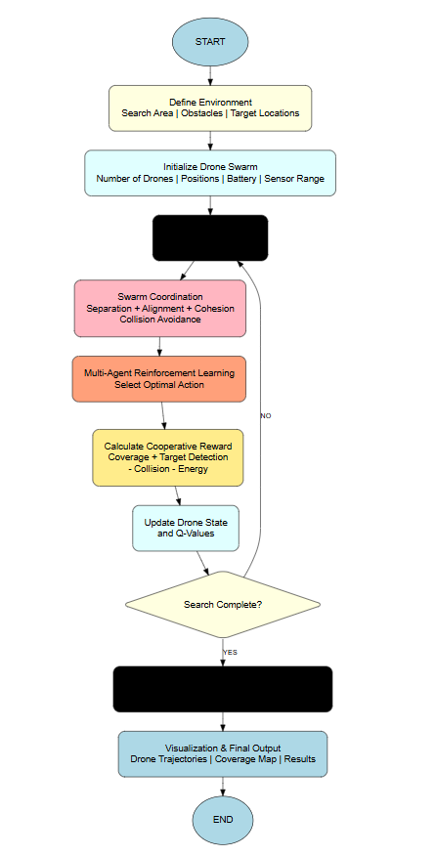
Methodology
Define Environment – Set the search area, obstacles, and target locations.
Initialize Drone Swarm – Set drone number, positions, battery, and sensor range.
Swarm Coordination & MARL – Coordinate drones and select optimal actions.
Reward & State Update – Calculate rewards and update drone states and Q-values.
Search & Output – Repeat until completion, then display trajectories, coverage map, and results.

Slide 9
Methodology
Proposed Algorithm for Cooperative Drone Swarm
Step 1: Define Environment and Drone Swarm
Let
E = Search Environment
D={D1​,D2​,...,Dn​} = Set of Drones
T={T1​,T2​,...,Tm​} = Target Locations
O = Obstacles
Bi​ = Battery level of drone Di​
Ri​ = Sensor range of drone Di​
The environment consists of a predefined search area containing obstacles and unknown target locations.

Slide 10
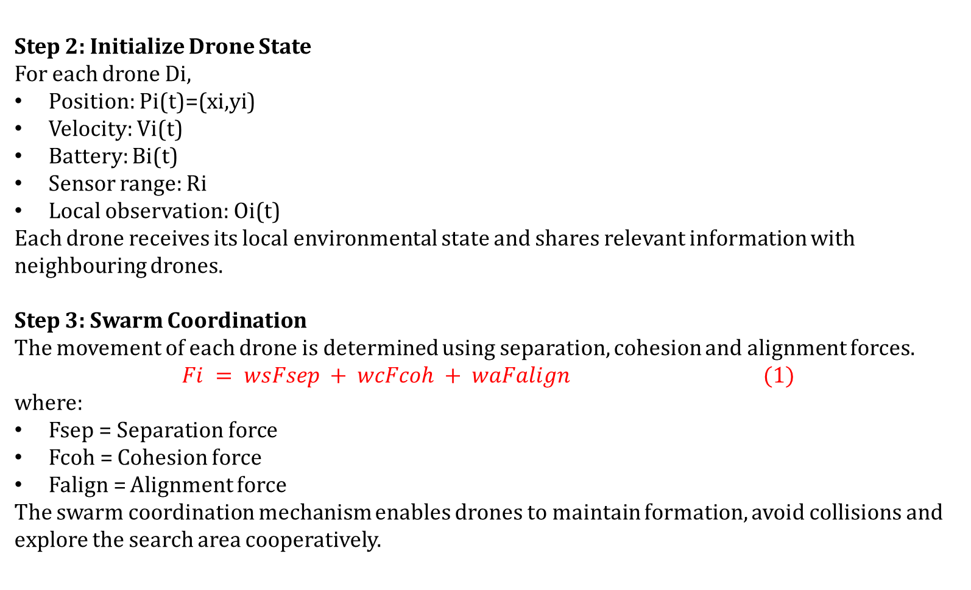
Methodology
Step 2: Initialize Drone State
For each drone Di​,
Position: Pi​(t)=(xi​,yi​)
Velocity: Vi​(t)
Battery: Bi​(t)
Sensor range: Ri​
Local observation: Oi​(t)
Each drone receives its local environmental state and shares relevant information with neighbouring drones.
Step 3: Swarm Coordination
The movement of each drone is determined using separation, cohesion and alignment forces.
$$Fi = wsFsep + wcFcoh + waFalign (1)$$
where:
Fsep​ = Separation force
Fcoh​ = Cohesion force
Falign​ = Alignment force
The swarm coordination mechanism enables drones to maintain formation, avoid collisions and explore the search area cooperatively.

Slide 11
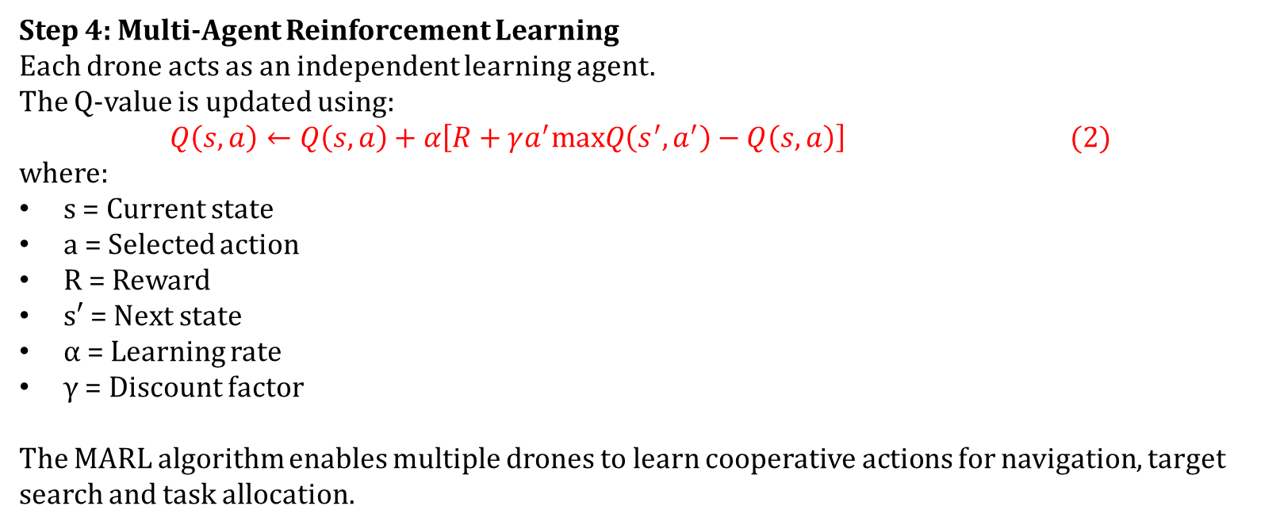
Methodology
Step 4: Multi-Agent Reinforcement Learning
Each drone acts as an independent learning agent.
The Q-value is updated using:
$$Q\left(s,a\right)←Q\left(s,a\right)+α\left[R+γa^{′}max​Q\left(s^{′},a^{′}\right)−Q\left(s,a\right)\right] (2)$$
where:
s = Current state
a = Selected action
R = Reward
s′ = Next state
α = Learning rate
γ = Discount factor
The MARL algorithm enables multiple drones to learn cooperative actions for navigation, target search and task allocation.

Slide 12
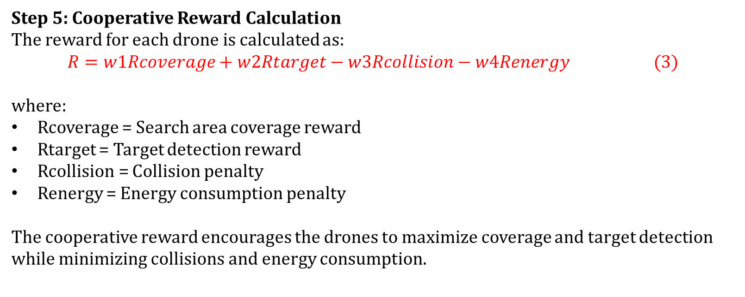
Methodology
Step 5: Cooperative Reward Calculation
The reward for each drone is calculated as:
$$R=w1​Rcoverage​+w2​Rtarget​−w3​Rcollision​−w4​Renergy​ (3)$$
where:
Rcoverage​ = Search area coverage reward
Rtarget​ = Target detection reward
Rcollision​ = Collision penalty
Renergy​ = Energy consumption penalty
The cooperative reward encourages the drones to maximize coverage and target detection while minimizing collisions and energy consumption.

Slide 13
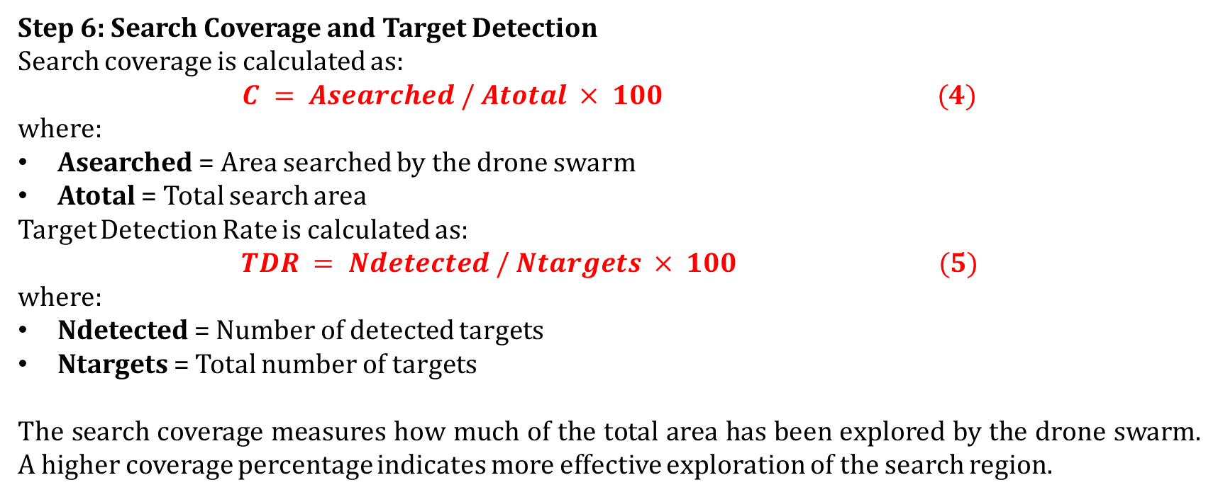
Methodology
Step 6: Search Coverage and Target Detection
Search coverage is calculated as:
$$C = Asearched / Atotal × 100 (4)$$
where:
Asearched = Area searched by the drone swarm
Atotal = Total search area
Target Detection Rate is calculated as:
$$TDR = Ndetected / Ntargets × 100 (5)$$
where:
Ndetected = Number of detected targets
Ntargets = Total number of targets
The search coverage measures how much of the total area has been explored by the drone swarm. A higher coverage percentage indicates more effective exploration of the search region.

Slide 14
The End

